Slide 1
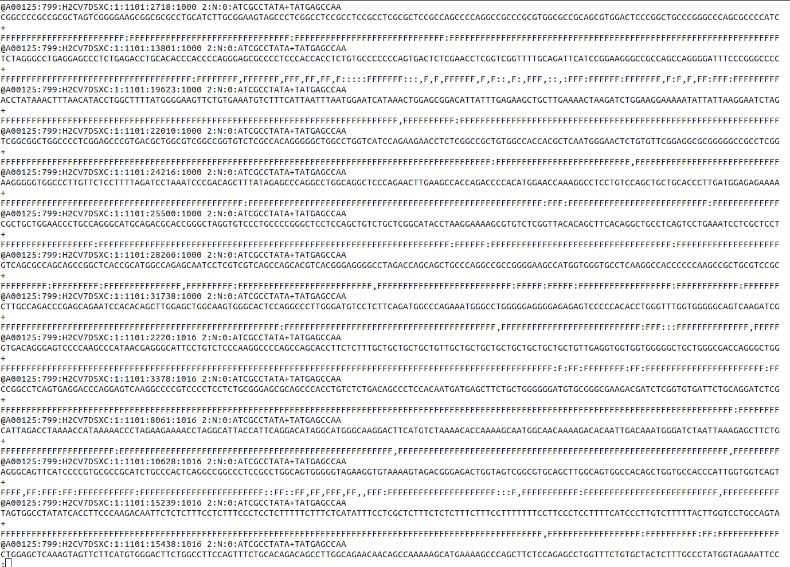
A
FASTQ
Reference
WGS of DNA circles
GRCh38
*.fastq
*.fasta
B
FASTQC
Quality Control
C
GRCh38 Restriction Fragments
Hi-C
python-script
BWA mem
Reference Genome
GRCh38
Read Mapping
BED file information:
Order number and restriction fragment end’s position
BED
BEDtools
bamtobed
BAM to BED conversion
RS removing
AWK
BED file information:
CIGAR, MAPQ, Mapping information, orientation and Read name.
BED
BED
BED file information:
Order number and restriction fragment end position without enzyme recognition sites
D
Removing RS from Reads
BEDtools
intersect
BED file information:
CIGAR, MAPQ, orientation, Read name and restriction fragment end’s position without enzyme recognition sites
BED
BED tools
intersect
Mapping Reads to Restriction Fragments
AWK
Distance calculation
from 5’ end’s Reads to RS
Read to RS Distance calculation
AWK
‘p’ & ‘q’ side assignment
based on Read side and orientation
Read side assignment
CIGAR & MAPQ
LPERs scoring
LPER
Order & Filtering
LPER Count
E
SV hypothesis & LPERS
SV Genotyping
HGVS Nomenclature
F
TSV
Read Name
Extraction
AWK
Filtering out LPERs
grep
SV algorithm calling
Lumpy
SvABA
GATK
BAM
TSV
Output: Browser extensible data (BED)
Input: Reads (FASTQ) and Reference (FASTA)
Work flow
Process
BED
FASTQ
Final Output: tab separated values (TSV)
Input/Output: Binary Alignment Map (BAM)
Program name and description / output file characteristics
Decision
TSV
BAM

